Slide 1
DDANALYTICS – PROJECT 1
SAMSON AKOMOLAFE

Slide 2
1. Question: In the dataset, what does Relationship Satisfaction mean...(relationship to manager, to peers)
Relationship satisfaction with superiors and/or peers refers to the level of contentment and positive feelings an individual employee experiences in their interactions and relationships with their coworkers, particularly those in positions of authority (superiors) and those at the same level (peers). Here’s a breakdown of what this concept entails:
Definition of Relationship Satisfaction:
General Meaning: Relationship satisfaction is a measure of how fulfilling and positive a person perceives and understand their relationships to be. It generally includes emotional, social, and psychological aspects of interactions their relationship.
At work environment context, this satisfaction can significantly impact an individual’s job performance, their engagement, and overall well-being. I am going to discuss 4 major topics that I think could positively impact relationship satisfaction at work environment;
Aspects of Relationship Satisfaction
Impact on Work Environment
Factors Influencing Relationship Satisfaction
Measurement
1. Aspects of Relationship Satisfaction: Open, honest, and effective communication between individuals contributes to higher satisfaction levels. This also foster feeling of being supported, trusting one’s superiors and peers enhances relationship satisfaction. Trusting helps form relationship of reliable colleagues and supervisors who provide guidance and feedback. Relationship satisfaction also leads to respect and recognition from superiors and peers. Ultimately, it helps in conflict resolutions when one arises.
2. Impact on Work Environment: The impact of positive relationship can not ne over-emphasized. High relationship satisfaction among peers can lead to better teamwork and collaboration, enhancing overall productivity. When employees are satisfied with their relationships at work, they are more likely to remain in their positions, reducing turnover rates. When employees are satisfied with their relationships at work, they are more likely to remain in their positions, reducing turnover rates.
Finally, job performance in positive work environment really boost up. It is the key to all-round high percentage of job performance.

Slide 3
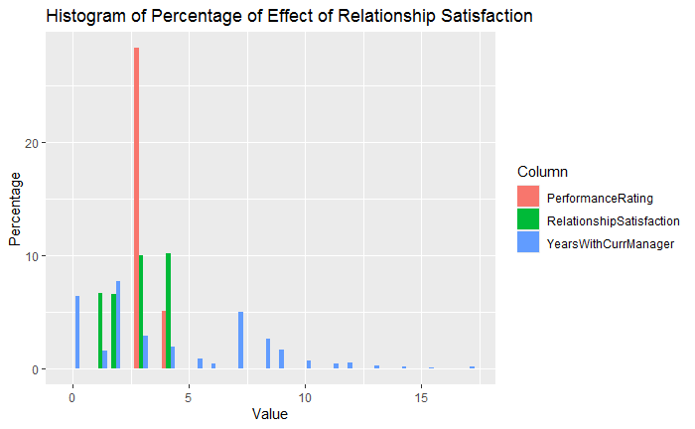
3. Factors Influencing Relationship Satisfaction: it is very important to ensure that good relationship culture is cultivate in work environment. Managers and those in higher level of management cadre should be involved through training and re-training. Management should enshrine transformational leadership, which emphasizes inspiration and support, this can really enhance satisfaction with superiors. Also the work-life balance or the personal life of their employee should be given great attention.
Example: An employee of Wells Fargo Bank died in the office in Arizona. She was discovered 4 days after she was dead. The medical examiner reported that she died from heart related attack.
This is an example of poor work-life balance which will definitely impact work
4. Measurement: Finally, management must ensure periodic measurement of relationship satisfaction by using surveys and questionnaires. Also through 2-way feedback mechanisms, regular feedback and check-ins can help to measure satisfaction levels and identify areas for improvement.
This plot shows that there is improved performance rating when the relationship satisfaction is highest.
Therefore, it is very important that relationship satisfaction between an employee and superior and peers.
This plot proved true the above position that I habe mentioned.

Slide 4
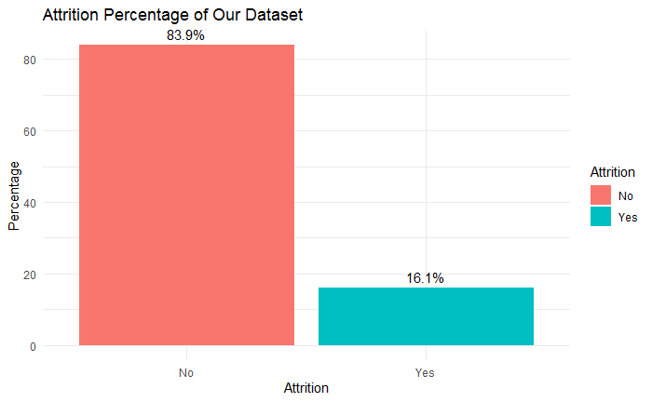
#3. Advice: When plotting and exploring attrition, the percentage of those who left is probably more useful #than the count
The %age of the employees whose attrition was YES in our dataset was 16.1%, while 83.9% was NO

Slide 5
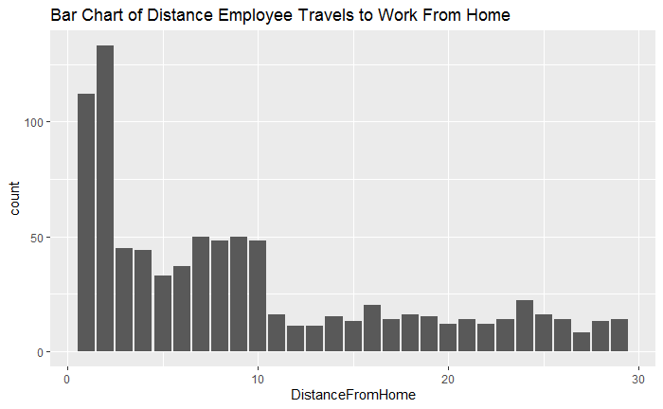
#4. Question: Is the dataset, is the distance from home in miles or kilos?#We don't have that information (however we do know whether its high or low)
Observation:
Most of the employees lives close to their work place.
33.3% of the employees travels below or 10 miles from home.
The number of employees whose home is 1 or 2 miles away are greater.
66.7%of the worker travels above 10 miles to get to work.
NB: The distance from home have to be in Mile and not Kilometers because the Company is located in the USA. The standard of measure for distance in USA is Mile.

Slide 6
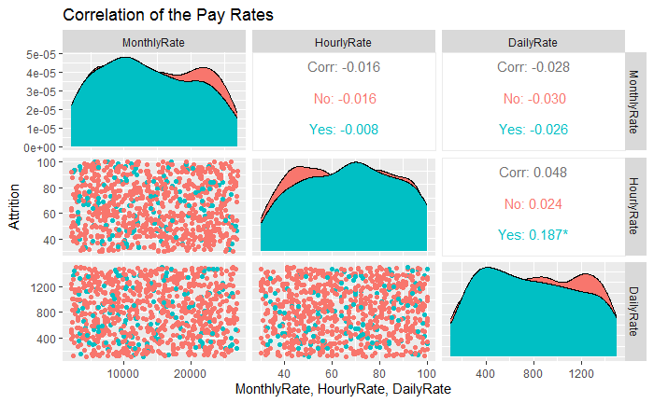
#5. Question: In the dataset: what is the definition of pay rates: Hourly, Daily & Monthly. These values to not seem to relate to each other or the Monthly Salary (which is different than Monthly Rate).
The plot above shows the 3 main pay rates application to the employees. Employee Job role and status generally determine the type of pay rate that would be used for them.
Salaried, top management staffers usually get are rated by monthly rate (get paid monthly or bi-monthly)
From mid-level to low management employees are usually paid by hour rate (get paid bi-monthly or weekly)
Daily rate workers could be contractors who are paid based on the job they are hired to do. Or they may be seasonal workers who are paid a fixed amount based on agreed terms which are not the same for all workers/employees.
Nevertheless, these variables contributed greatly to workers/employees who decided to leave as we shall see shortly in my presentation.

Slide 7
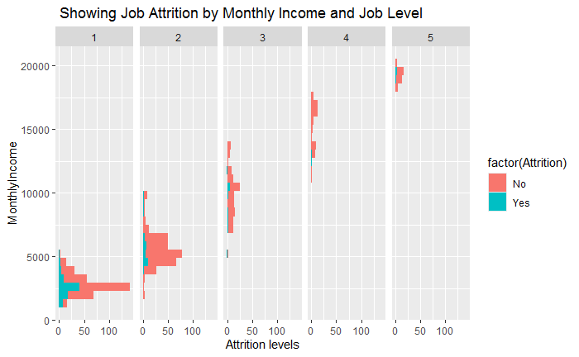
#6. Question: In the dataset: we do see that Job Levels go from 1-5 and assume that 1 may symbolize a lower #level employee, but this is not defined.
Though this level does have evidence of a positive linear #relationship with Monthly Income, it does not seem to correlate well with the Job Titles. in other words #someone with a Director can be a 2-5, and manager a 3-5.#Yes we can assume 1 is a lower job level than 5.
Observation:
Though the dataset didn’t provide clear distinction of the Job level as it relates to the Job title, but I have reasonable evidence to show from the plot that the Job level and Monthly income variables in the dataset relates inversely proportional to Attrition.
The plot shows that lower job level of 1 with monthly income of no more than $5000/month has the greatest levels of Attrition.
The higher the job level, the lower the levels of attrition.
Yes I can confidently assume that 1 is a lower job level.

Slide 8
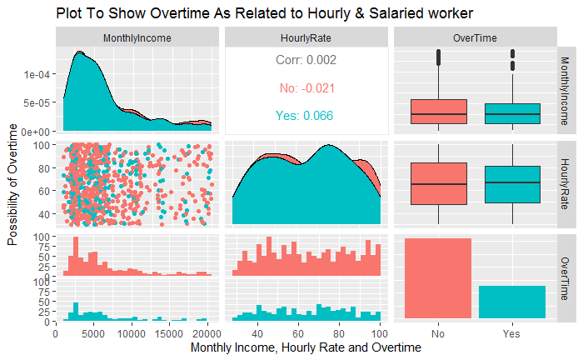
#7. Question: In the dataset, does overtime mean Hourly vs. Salaried worker?

Slide 9
#8 Question: In the dataset, Performance Ratings are only 3 & 4, is there a mistake? Unless a corrupted system, hard to imagine ratings consistently high, even as 2 still means "good". It is self-reported data, think about why the employees may only answer 3 and 4
It’s generally unusual for performance ratings to be done only at the higher end (3 and 4) of the rating scale, especially when a scale typically includes lower ratings like 1 and 2. But there are potential reasons for this pattern to be seen in self-reported data. These may include some of the following;
Self-Selection Bias: Employees are inclined to rate themselves higher due to their personal biases, wanting to present themselves in a positive light or to align with perceived expectations and perception of their peers.
Fear of Repercussions: When performance evaluation is linked to job security, promotions, or bonuses, employees might choose higher ratings out of fear of negative consequences.
Cultural Factors: Stigma associated with lower performance ratings can be institutionalized in some organizational cultures, so employees might feel pressured to conform to a culture of positivity and high performance.
Incentive Structures: If the organization's reward systems are heavily focused on high performance, employees may focus their self-assessments on the upper tier of the rating scale.
Lack of Clarity: if employees did not fully understand the criteria for each rating level, it may lead to a tendency to rate themselves higher if they perceive their performance as "good" without knowing what constitutes a higher rating.
Recommendations:
1. Data Review: Review of data collection process for any inconsistencies or biases may be considered to reduce this anomaly.
2. Anonymous Feedback: Implementation of anonymous feedback mechanisms maybe deployed in order to encourage more honest self-assessments.
3. Clear Evaluation Criteria: Ensuring that employees understand the rating scale and criteria clearly can facilitate more accurate self-assessments.
4. Regular Audits: Conduct regular audits of performance ratings to check for patterns that may indicate issues in the self-reporting process.
Understanding these factors can help in interpreting the data more accurately and addressing any potential issues in the evaluation process.

Slide 10
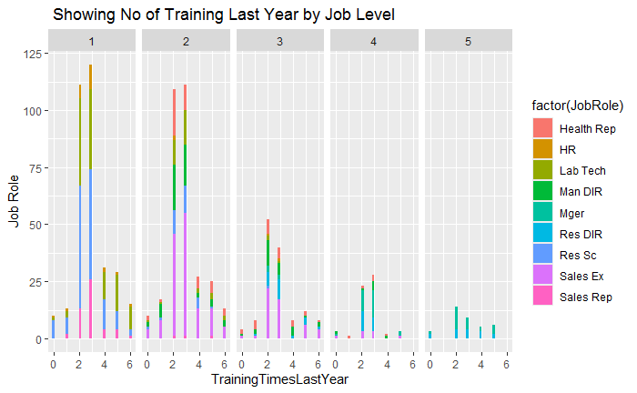
#9 Question: In the dataset, does Training times mean: hours, weeks, or instances and over what period?
Training times last year means number of training sessions attended by the employee.

Slide 11
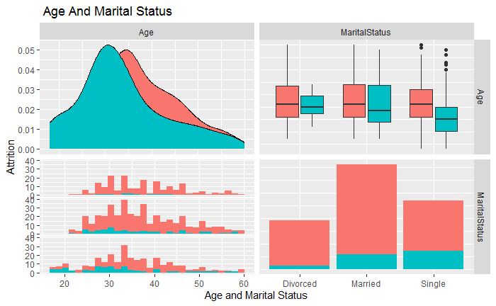
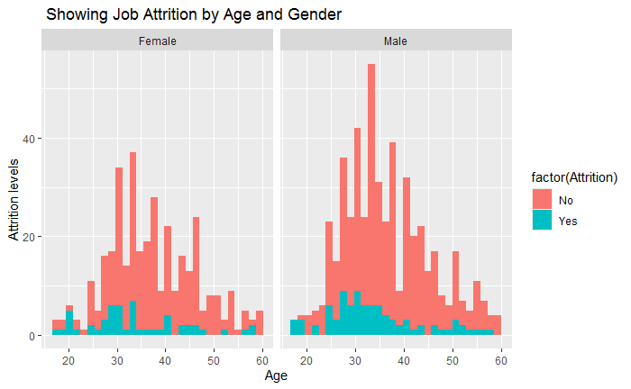
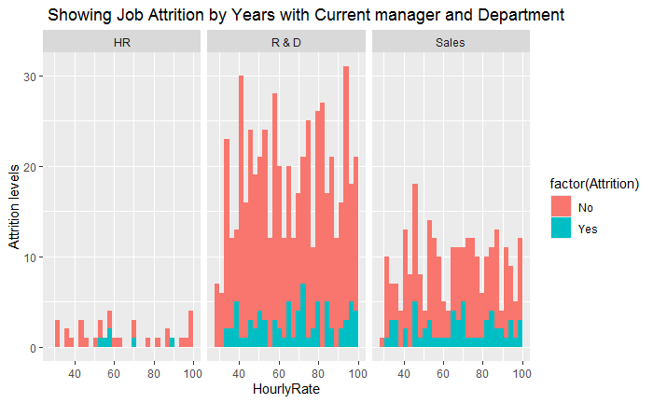
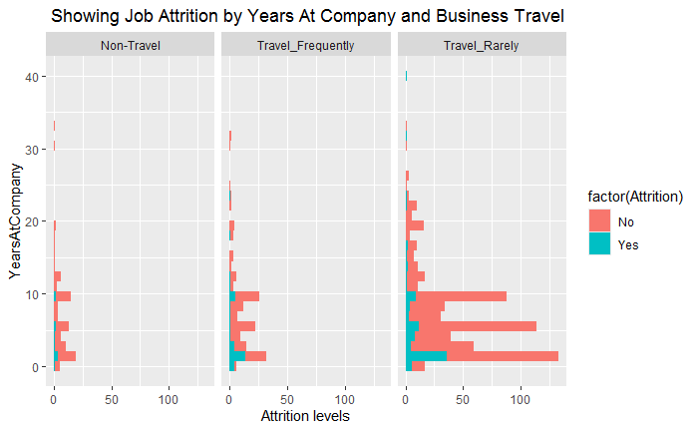

Slide 12
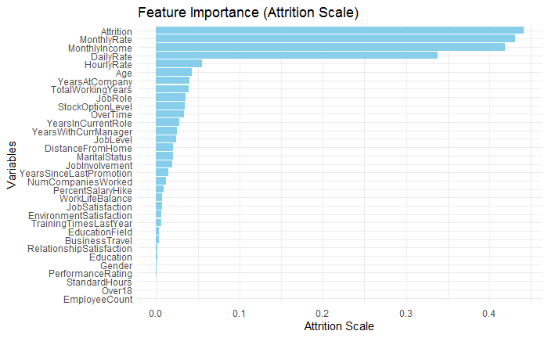

Slide 13
TAKEWAYS AND RECOMENDATION
Takeaways
The top 3 attrition factors are monthly rate, month income and daily rate based on my model.
Others are hourly rate, age, years at company, total working years and so on.
Single mid-age male employees within the age of 30 and 40 years of age are more likely to leave if all the conditions in the model is true.
Also, life scientist are more likely to attrite and those who are working in the research and development department as well as sales department.
Recommendation
1. Enhance Onboarding and Training
2. Foster a Positive Work Environment.
3. Provide Competitive Compensation and Benefits
4. Career Development Opportunities
5. Work-Life Balance
6. Recognize and Reward Contributions
7. Conduct Exit Interviews
8. Engage Employees Regularly
9. Support Employee Well-Being
10. Leadership Development
Conclusion
Reducing employee turnover requires a holistic approach that addresses various aspects of the employee
experience. By creating a supportive, engaging, and rewarding workplace, businesses will foster loyalty
and commitment, ultimately leading to lower turnover rates.

